Slide 1
Music Recommendation System
Big Data and Intelligent Analytics
Group 7
Tanmay Ingle
Bhaskar Akula

Slide 2
Introduction
Recommendation Systems
Implicit Dataset
Explicit Dataset

Slide 3
Tools and Significance
Apache Spark
Amazon EMR
Flask
IPython Notebook
CherryPy

Slide 4

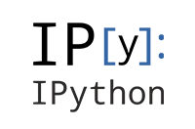
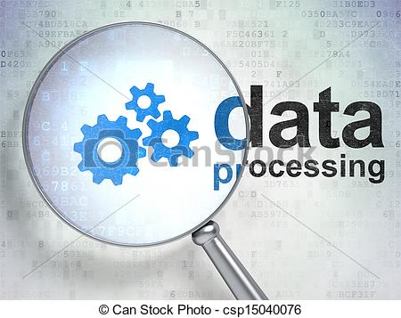




Workflow

Slide 5
Data Acquisition and Storage
Dataset – Implicit, Explicit
Storage – S3
Data Preprocessing
Outliers
Null values
Irregular data

Slide 6
Model Building and Tuning
Alternating Least squares
Metrics
RMSE
Mean Average Precision

Slide 7
Deployment
Flask – python based microframework
CherryPy – Web Server

Slide 8
Future Scope
Spark Streaming
Mean Average Precision
Elastic Beanstalk

Slide 9
Thank You

